Slide 1
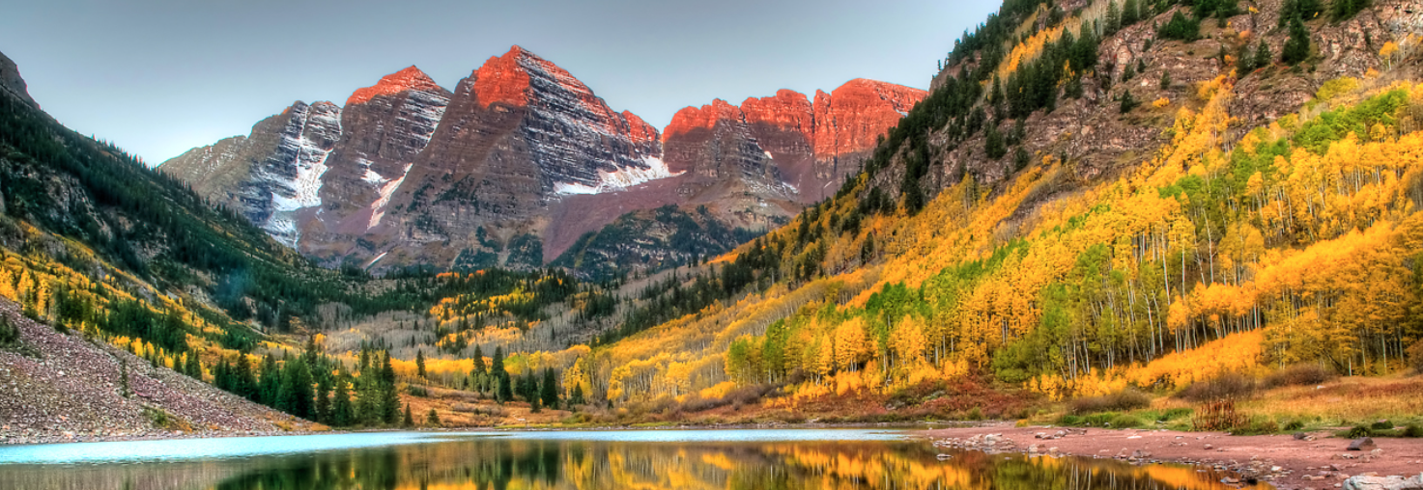
Dos and Don’ts for Using Climate Change Information in Water Resource Planning and Management
Julie Vano (NCAR), Jeff Arnold (USACE), Bart Nijssen (University of Washington), Martyn Clark, Andy Wood, Ethan Gutmann, Nans Addor, Joe Hamman, Flavio Lehner (NCAR)
www.fs.usda.gov
Visit to Seattle District Office USACE
March 30, 2018

Slide 2
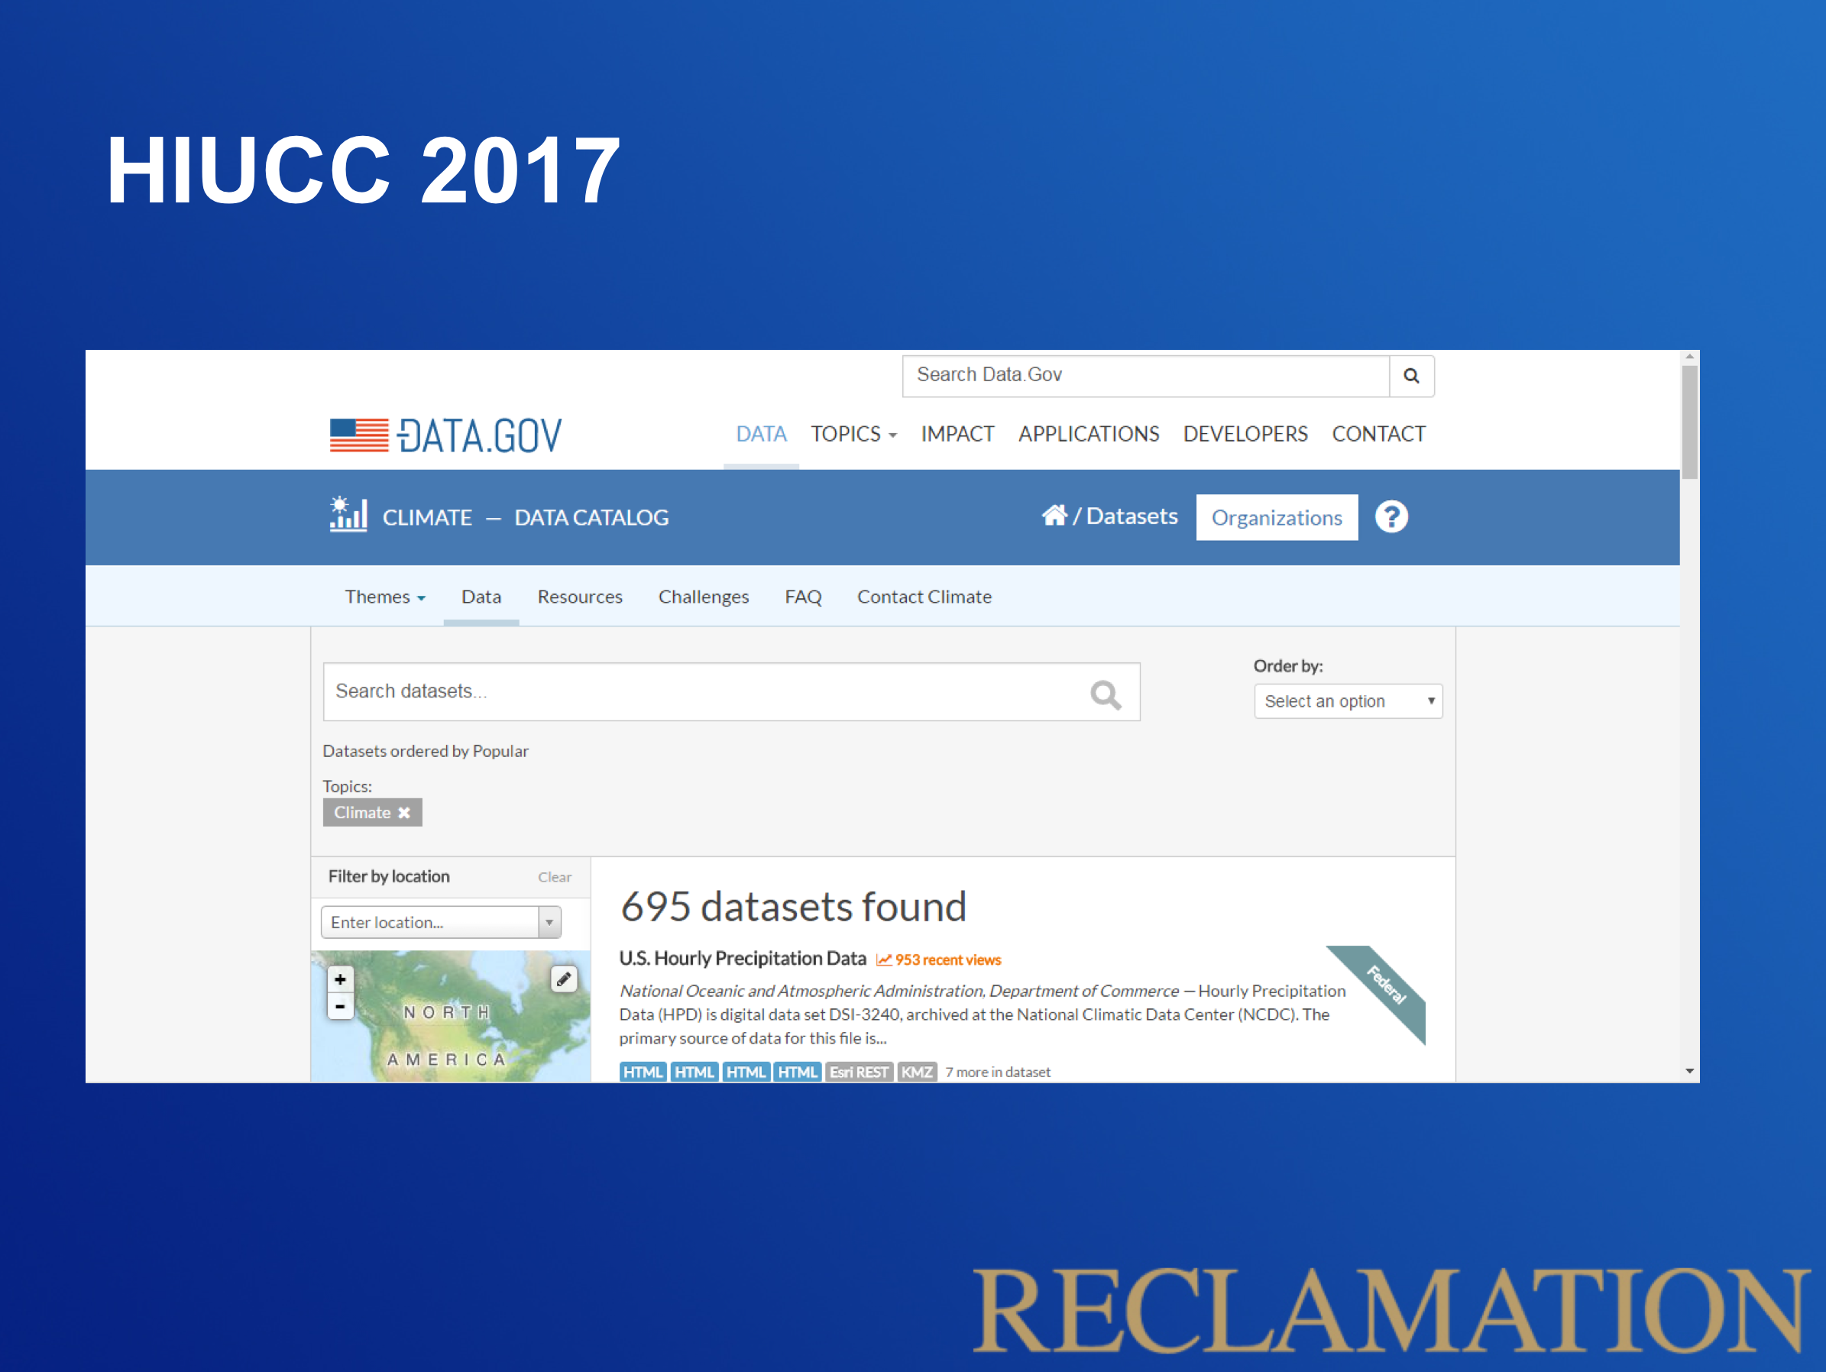

What information should water managers and planners use??
Image from
http://www.activatedesign.co.nz
Slide from Ken Nowak at Reclamation
Notes:
Since initial offering, climate data, tools, and methods have grown/expanded considerably
In light of the proliferation, re-tooled to add content to assist in navigating these data and decisions toward informed, technically sound assessments

Slide 3
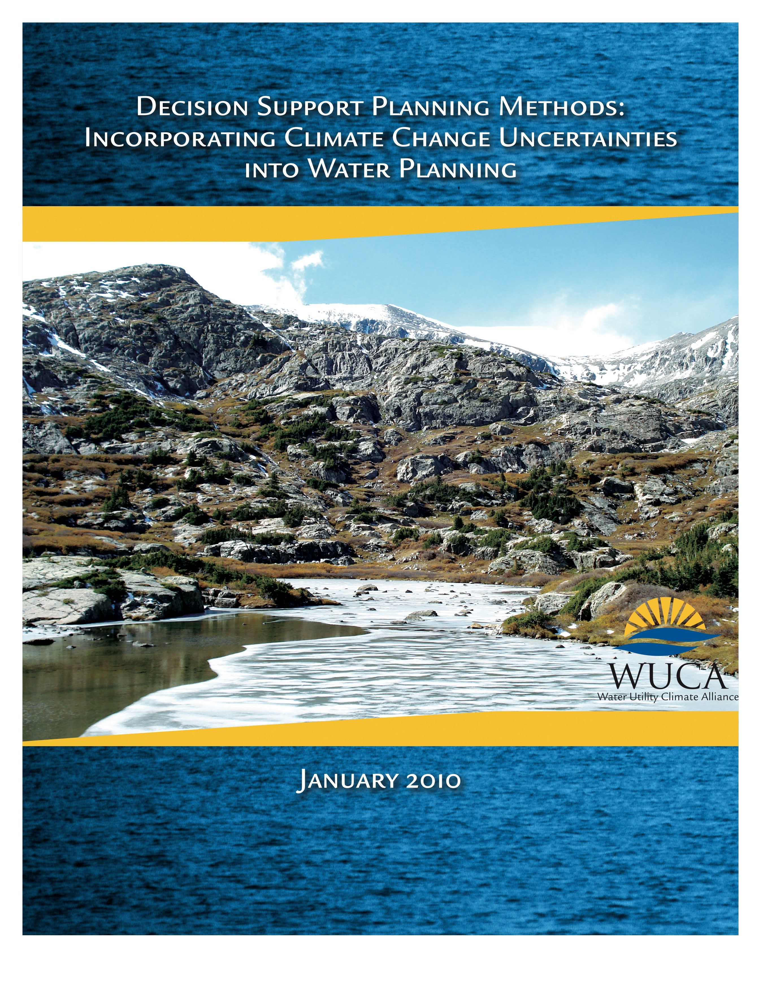
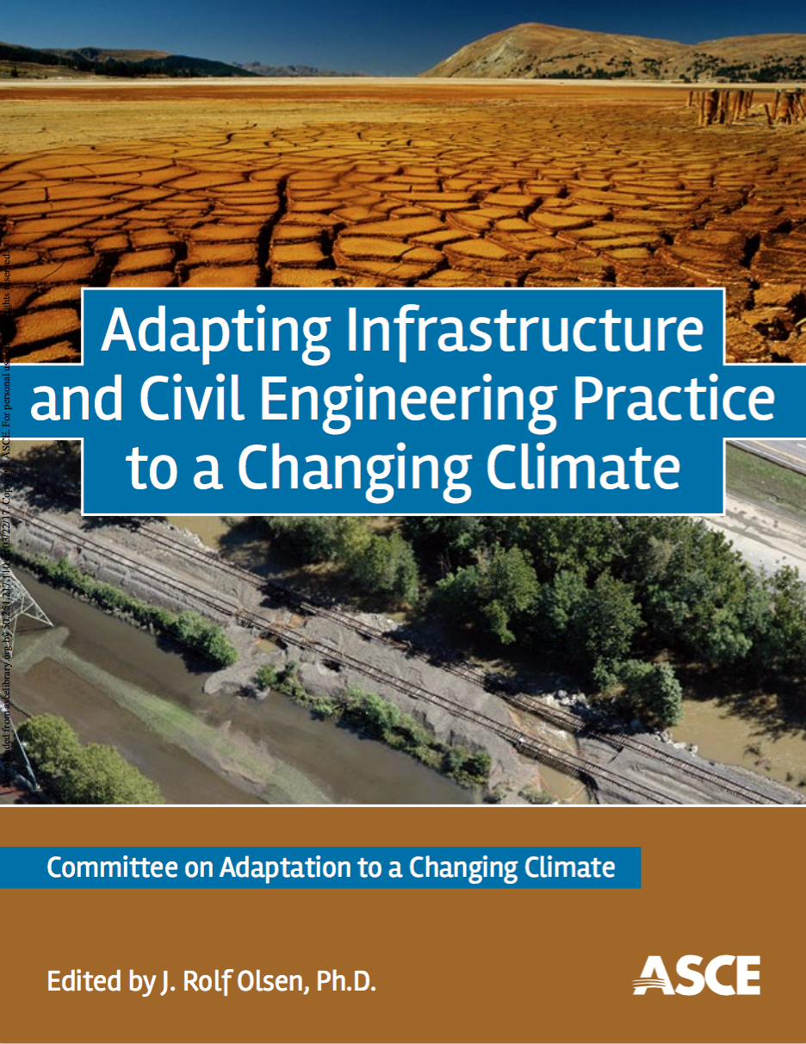
Increasingly more guidance…
Climate information guidance
and others, including NRC reports, IPCC, NCA…

Slide 4
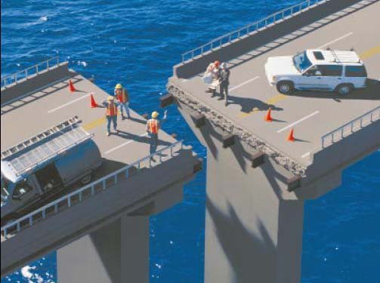
Note: photo for illustration purposes, found by googling “mismatched bridges”
Scientists often unaware of how their information is being used.
Water managers often unsure what information to use and how to use it.
How can we change this…

Slide 5
















DOS and DON’TS for using climate change information in water management
Notes:
Tricky, because there is so much “it depends” and some questions are unanswerable with current info…

Slide 6
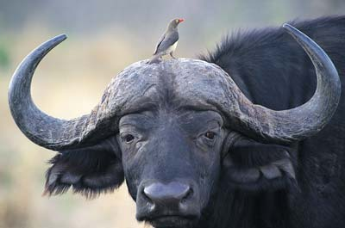
PRIMARY AUDIENCE:
Water resource managers
however, the applications framing may be (more) helpful for researchers
symbiotic information exchange

Slide 7
DOS and DON’TS Guidelines
Primary audience = water resource managers
I. It is important evaluate climate risk
II. Models can be helpful tools, if used appropriately
III. Uncertainty is everyone’s responsibility
Organized into:
Guiding principles (3)
Study design recommendations (9)
Model selection recommendations (6)
Interpreting results recommendations (8)
Study design example:
Do plan for iterations as the first time you download data should not be your last
Model selection example:
Don’t use a finer spatial scale or temporal resolution that what is appropriate for your climate change question
Interpretation example:
Don’t use routed streamflow as input to a reservoir model if biases have not been removed

Slide 8
Do be aware of multiple ways to evaluate future change (climate scenarios are helpful, but there are other tools too)
Recommendation example
Why?
Climate change scenarios can provide valuable information to help better understand how the past will differ from the future. They reveal a non-stationary climate and are often the best tool available. They do, however, have limitations. Even when climate change scenarios are being used, other investigations may add important insights
Frequently asked questions, real world examples
What are different approaches to evaluating future change?
Scenario studies, Paleoclimate studies, Stochastic hydrology studies, Climate-informed vulnerability analysis
How do approaches differ?
Vary in complexity, differ in the order in which they evaluate aspects of the system…
How do approaches similar?
Their goals are to better understand how the past will differ from the future, and aim to find low-regret, robust alternatives that do well across a range of possible futures. Most use global climate model information to inform the process.
Path forward
Recognize there are multiple ways to consider future change. Approaches include climate scenarios, paleoclimate, stochastic hydrology, and climate-informed vulnerability studies. Together these broaden our understandings and explore vulnerabilities from multiple important angles.
Notes:
“it depends” but the goal is to explain what it depends on and why

Slide 9
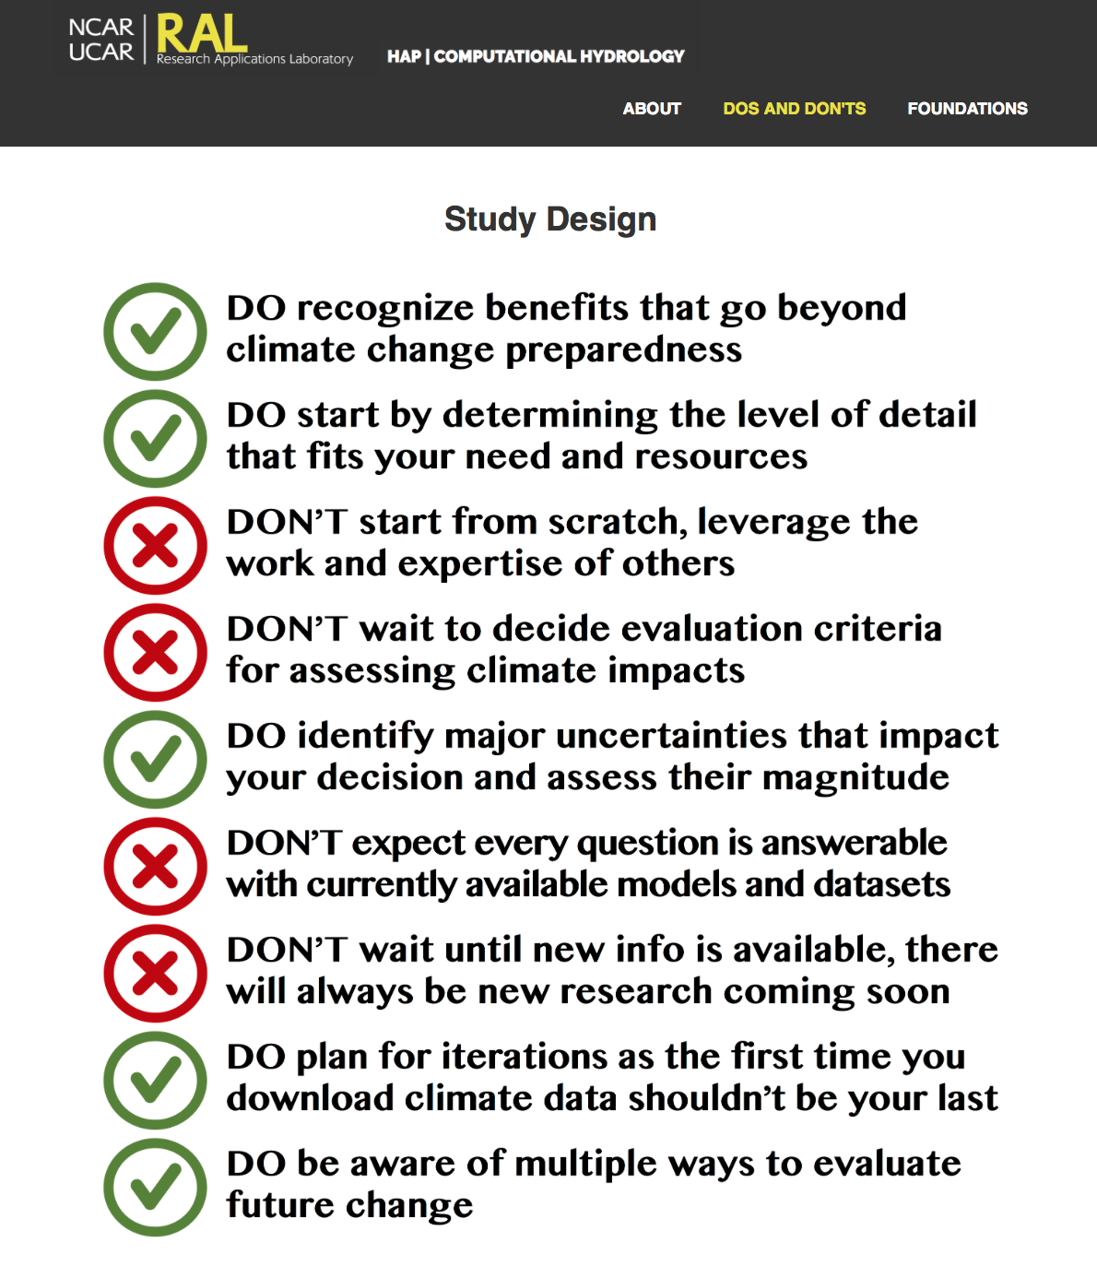
DOS and DON’TS Guidelines
Built on previous guidance
Promotes better understanding, applications framing helpful for research
Fosters conversation, usually exceptions to every rule but without defining the rule, cannot define the exception
Provides for multiple levels of engagement, designed in layers
Allows for updates that are transparent and version controlled (github)
Version 2.0 coming soon…

Slide 10
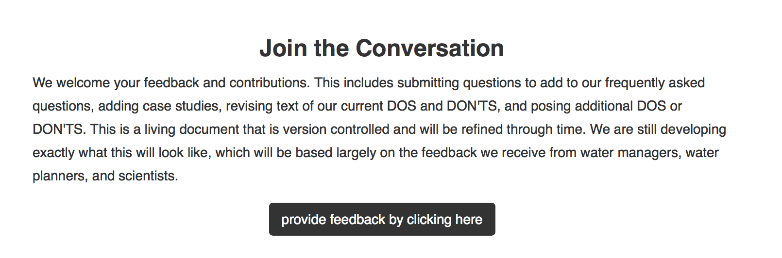
Test drive at…
Contribute at…
website prompts, github site, or jvano@ucar.edu
https://julievano.github.io/dos_and_donts_beta

Slide 11
ADDITIONAL SLIDES

Slide 12
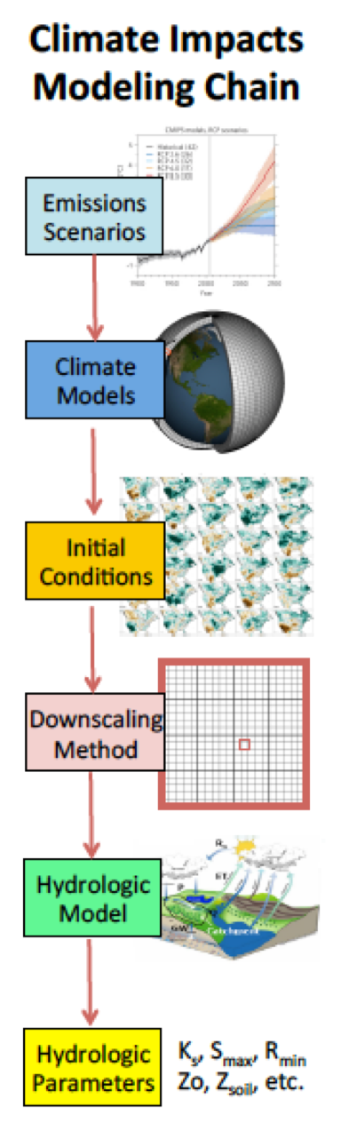
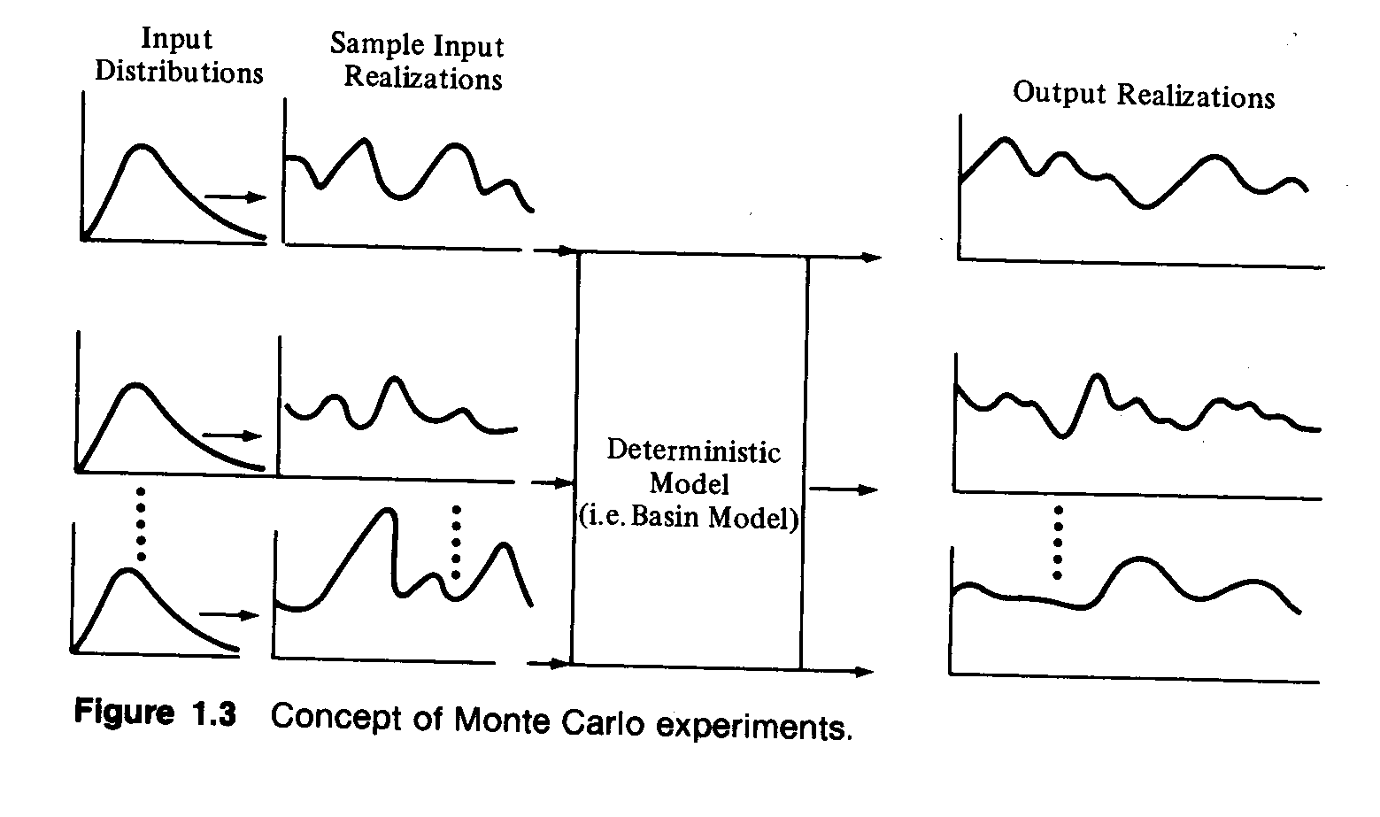
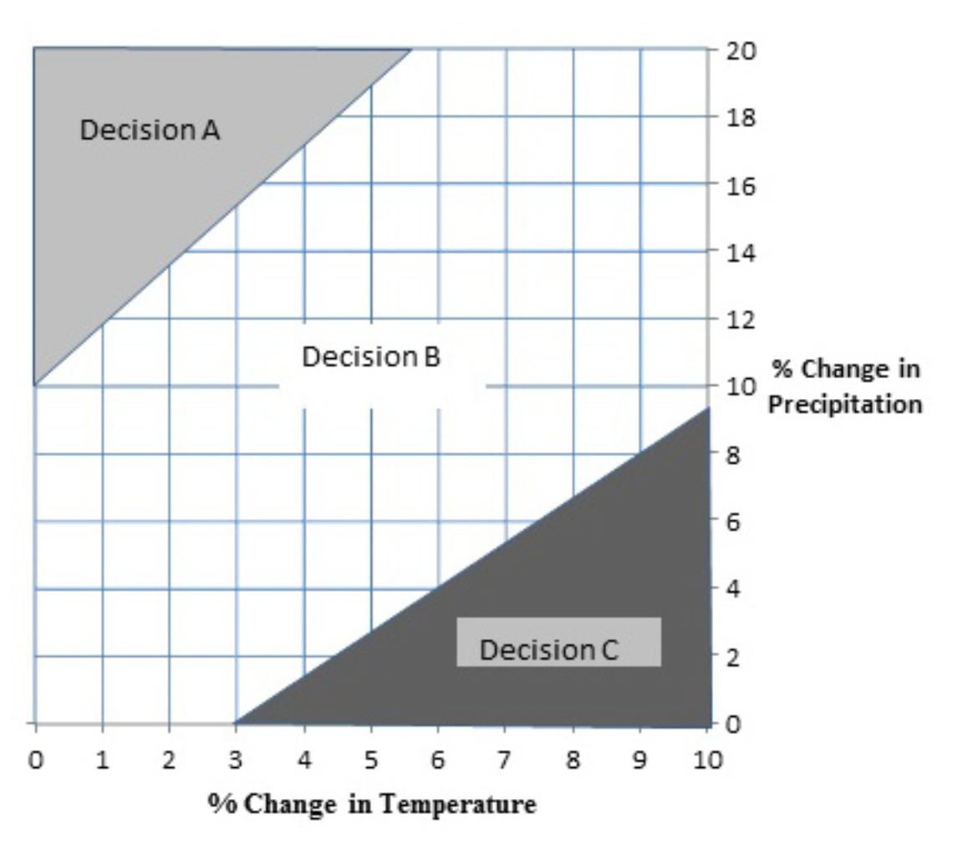
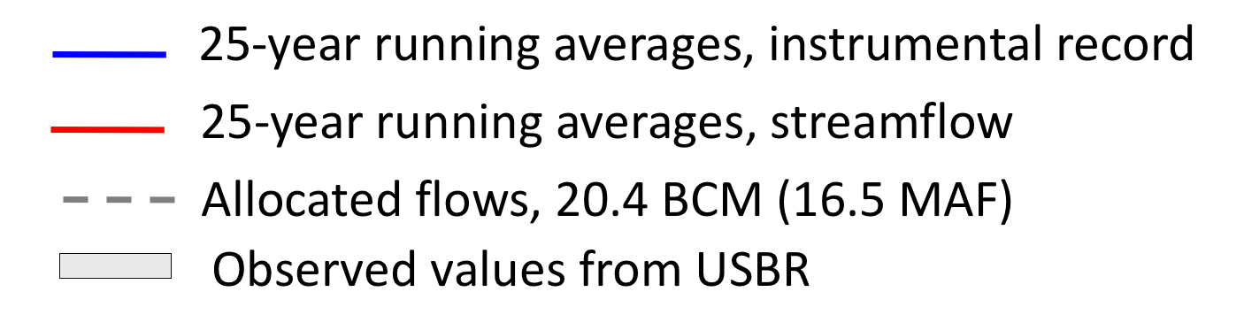
Do be aware of multiple ways to evaluate future change
Scenario studies
Climate-informed vulnerability analysis
Stochastic hydrology
Bras and Rodriguez-Iturbe, 1985
Paleoclimate studies
Brown et al., WRR, 2016
Clark et al. 2016
80% confidence
intervals
Vano et al., BAMS, 2016

Slide 13
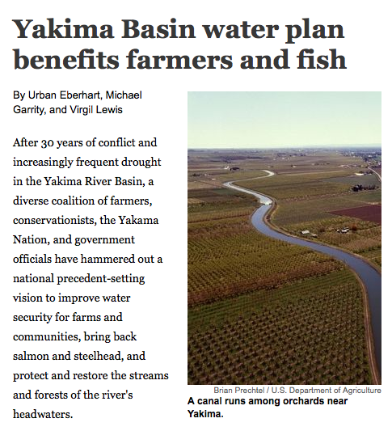
Do recognize benefits beyond climate change preparedness
Historical
2020s
2020s range
2040s
2080s
Figure from McGuire Elsner et al., Climatic Change, 2010

Slide 14
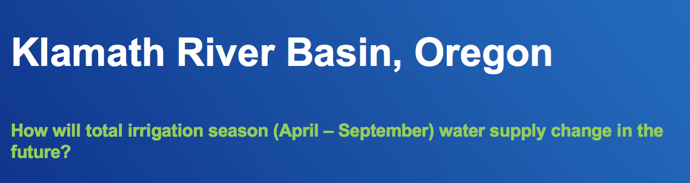

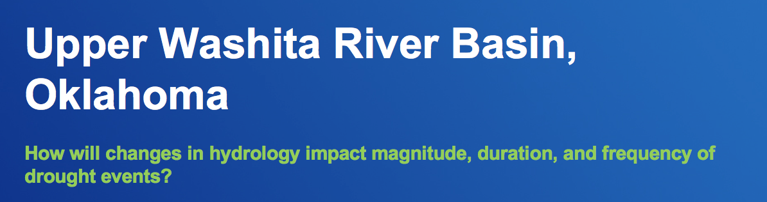
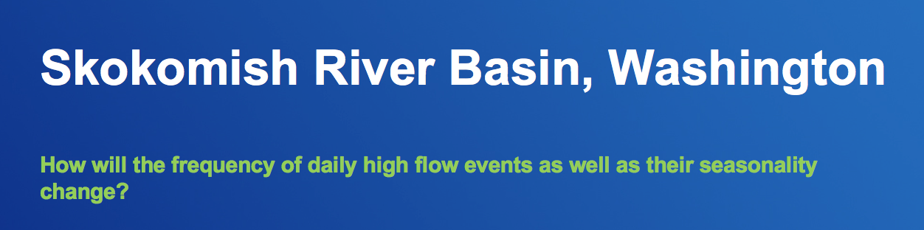
Do start by determining the level of details that fits your need and resources
What are the questions I am trying to answer?
water supply for irrigation, streamflow timing, drought, daily high flows

Slide 15





Do start by determining the level of details that fits your need and resources
Additional considerations
How much will it cost?
How long will it take?
To what extent will the analysis improve the decision?
Can appropriate data and information be obtained?
Who will undertake the analysis?
?
?
List from UK Climate Impacts Programme’s report Climate adaptation: Risk, uncertainty and decision-making
Notes:
How much will it cost?
tool development, staff time, expert assistance
How long will it take?
no matter how useful the tool, it is of little use if it cannot make the decision deadline
To what extent will the analysis improve the decision?
what information is required to make a different decision
Can appropriate data and information be obtained?
if not, reconsider costs and timeline
Who will undertake the analysis?
in-house, external expert

Slide 16
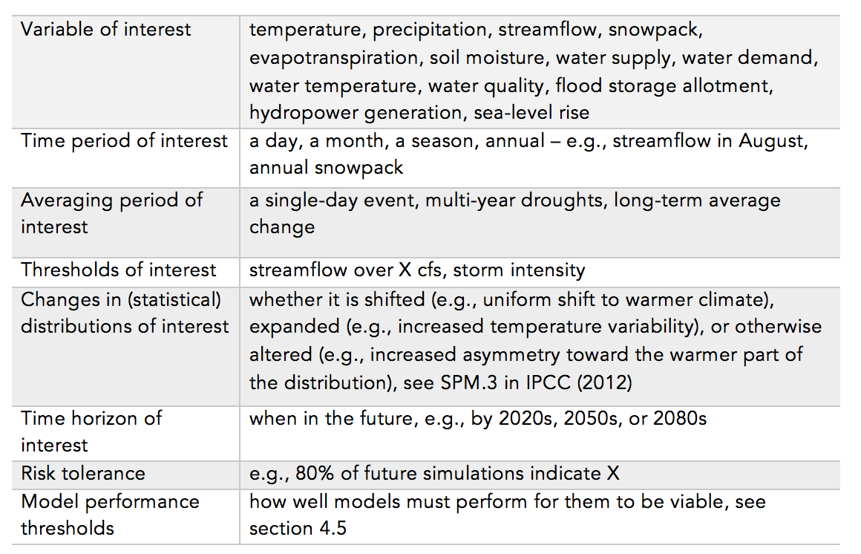
Don’t wait to decide evaluation criteria for assessing climate impacts
What variables matter most? At what time of year?
For how long?
What magnitude?
When in the future?

Slide 17
Don’t wait, there will always be new research and models coming soon
Research will continue to evolve
Often the biggest challenge is the first time through
Automate when possible
Common challenges the first time through:
learning where and how to download the data
using unfamiliar data formats (e.g., NetCDF)
slicing data for a particular region or time period
converting from one data format to another
automating the process
running new extremes through a reservoir model
defining evaluation criteria
displaying results in meaningful ways
Image from http://www.activatedesign.co.nz

Slide 18
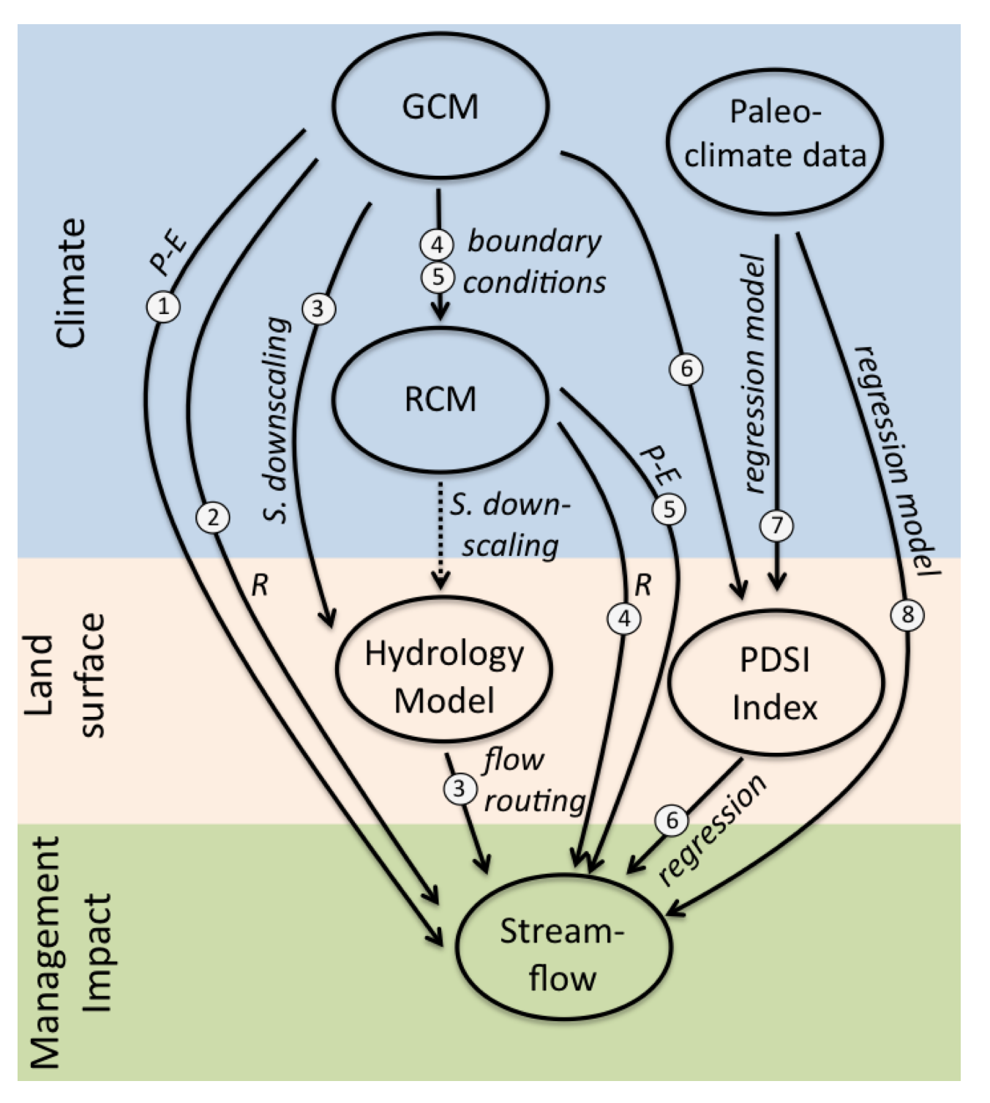
Do not treat all future projections or methods equally
Certain models and methods are more appropriate
Certain spatial and temporal scales are more appropriate for certain questions
Realize some questions may not be possible to answer with current knowledge
Finer resolution in space and time is not necessarily better
Higher Resolution ≠ Higher Accuracy
Be a savvy consumer and remember…
Different: GCMs, emission scenarios, spatial resolution, hydrology, +
Figure from Vano et al., BAMS, January 2014

Slide 19
no model is perfect
“The accuracy of streamflow simulations in natural catchments will always be limited by simplified model representations of the real world as well as the availability and quality of hydrologic measurements.” (Clark et al., WRR, 2008)
Do not expect perfect results,
not prediction, but a tool to test how system responds (what if scenarios)
BUT we can make better choices…
seek simple yet defensible (don’t need a Cadillac)
be aware of models shortcomings (know the warts)

Slide 20
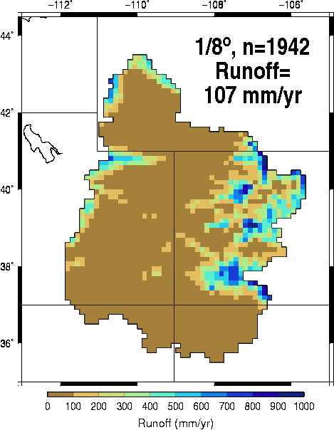
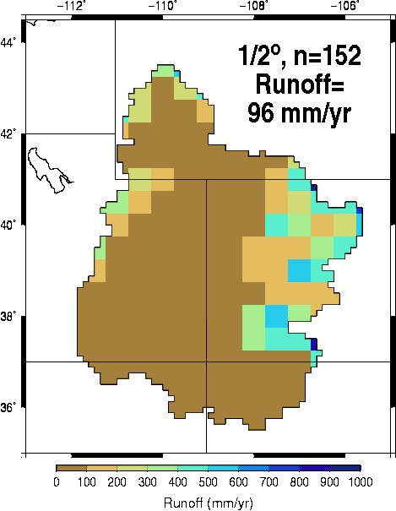
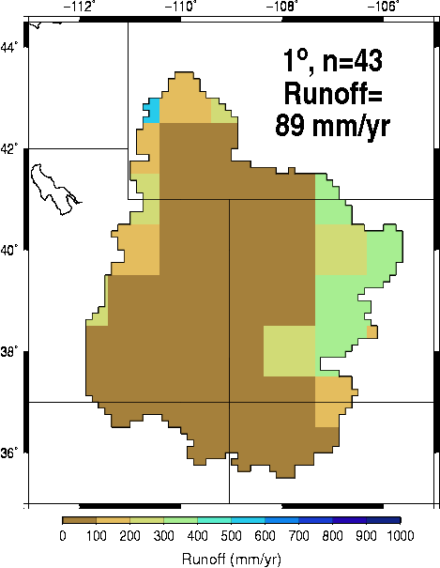
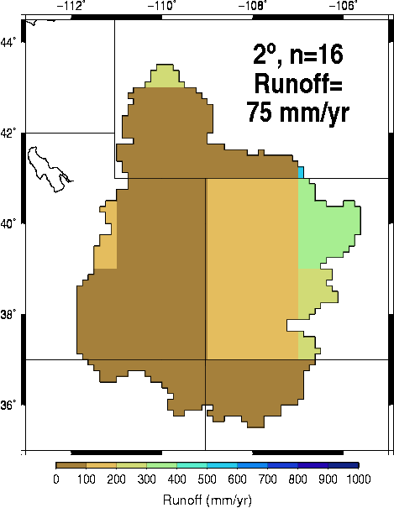
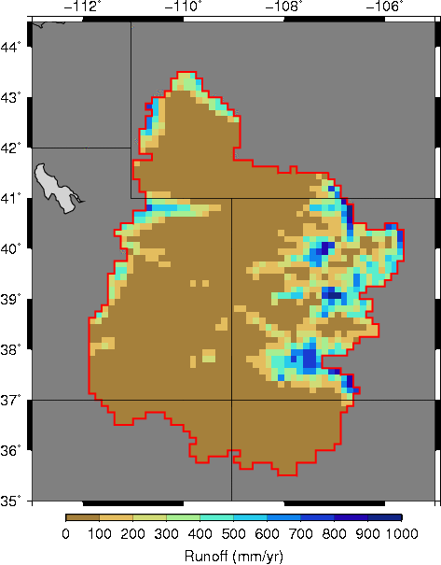
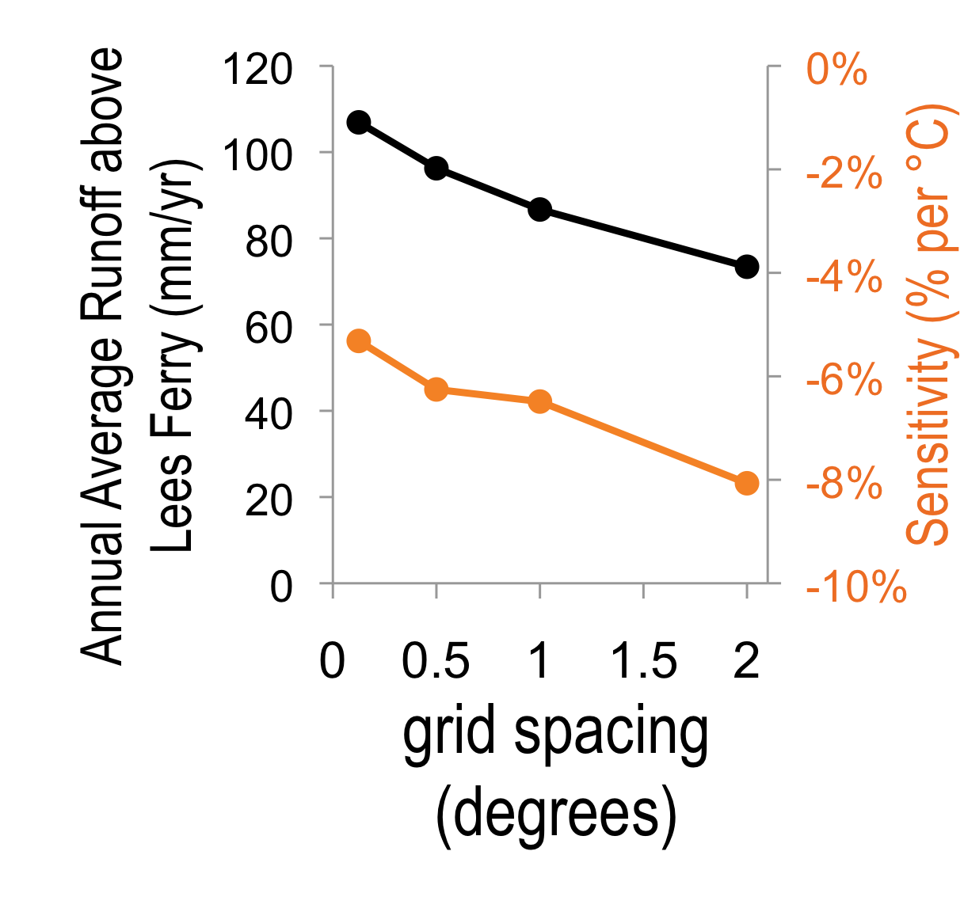
0 100 200 300 400 500 600 700 800 900 1000
Runoff (mm/year)
Spatial scale and topographic dependence of climate change projections
Figure from Vano et al., BAMS, January 2014
Notes:
The 2nd key source of uncertainty… spatial scale and topographic dependence (The models’ spatial resolution, which is important for capturing topography and its effect on the distribution of snow in the Colorado River’s mountainous headwaters.)
85% of flows from 15% area
To demonstrate this, we used a simple water balance model and ran it at different spatial resolutions using the same forcing data. As the line graph shows, as the grid sizes get larger, the runoff declines and sensitivity of the runoff to climate change gets more negative
Essentially, coarse spatial resolution does not resolve high elevation hydrologic processes that dominate basin runoff production

